Slide 1
Day 7 - Looking Ahead
UMN CSS Workshop 2025
Instructor: Alvin Zhou

Slide 2
Group
Group 1
Gretchen Corcoran
Jikai Sun
Shreepriya Dogra
Jialu Fan
Group 2
Jiacheng Huang
Paulina Vergara Buitrago
Jong Won Lee
Eun Sun Kyoung
Group 3
Sijin Chen
Michael Ofori
Jinny Zhang
Dongwook Kim
Group 4
Raj Wahlquist
Nicole Marie Klevanskaya
Wenhui Cheng
Rita Rongwei Tang
Mixed background and coding skills
Group members who are confident in their coding skills, please help other members during the afternoon coding labs

Slide 3
Learning Goals
Is CSS a paradigm? What does that mean?
Watts (2017): Solution-Oriented Social Science
Wallach (2018): CSS ≠ CS + Social Data
Methodological Triangulation and Mixed Methods
Social Good and the Politics of Knowledge
What’s Next? Large Language Models, Ethics, and Scale

Slide 4
What Is a Paradigm?
Thomas Kuhn (1962): Paradigms are frameworks that guide scientific inquiry: what questions are asked, how they’re answered, and what counts as “progress.”
CSS is more than a toolkit—it’s a shift in:
Objects of study (e.g., behavior, interaction, policy outcomes)
Evidence (e.g., digital exhaust, embedded sensors)
Methods (e.g., machine learning, agent-based models)
Epistemology (e.g., hybrid of prediction and explanation)

Slide 5
Watts (2017): A Call for Reorientation
“Should social science be more solution-oriented?”
Traditional social science overemphasizes explanatory depth at the expense of solving real-world problems.
Incentive distortion: We value elegant theory more than actionable insight.
Model complexity ≠ accuracy: Simple models can work surprisingly well.
“Explain first” bias: We delay solving problems, waiting for perfect understanding.
CSS Potential:
Combines prediction + experimentation + scalability
Enables policy simulation, rapid prototyping of interventions
Redefines “contribution” in terms of impact, not just theory

Slide 6
Wallach (2018): CSS ≠ CS + Social Data
You can’t just throw social data into computer science models and call it CSS.
Key tensions:
Epistemological mismatch: CS prioritizes performance; social science prioritizes inference and interpretation.
Context collapse: Scraping social media strips away the social context embedded in communication.
Data ≠ Truth: What’s observable online isn’t the same as what’s meaningful offline.
CSS requires bridging—not blurring—disciplinary logics.

Slide 7
What do you think?
Is computational social science changing the how and why we do social research—or just the what we research in social science?

Slide 8
Looking Ahead
If the discussion of CSS philosophy is too high-level, what can we do in practice when conducting our studies?
Some Directions I Think That Are Valuable
Computational Storytelling:
Molding data, questions, and methods simultaneously
One Story, Deeply Told
DEMM Framework (Description → Experimentation → Mediator/Moderator identification)
Methodological Triangulation
Social Good and Ethical Imperatives

Slide 9
Molding data, questions, and methods
Good CSS doesn’t just apply a method to a dataset—it reshapes data, questions, and methods simultaneously.
I will swiftly introduce three studies of mine to illustrate the point.

Slide 10
Study 1
Zhou, A., Yang, T., & González-Bailón, S. (2025). The puzzle of misinformation: Exposure to unreliable content in the United States is higher among the better informed. New Media & Society, 27(3), 1526–1543. https://doi.org/10.1177/14614448231196863

Slide 11
RQs and Findings
RQs
Citizens who maintain healthy news diets need to:
1. Limit misinformation exposure
2. Seek news from ideologically diverse sources
But what’s the relationship between the two?
Findings
Three things that we want:
Read more news
Read more diverse news
Don’t read misinformation

Slide 12
RQs and Findings
RQs
Citizens who maintain healthy news diets need to:
1. Limit misinformation exposure
2. Seek news from ideologically diverse sources
But what’s the relationship between the two?
Findings
Three things that we want:
Read more news
Read more diverse news
Don’t read misinformation
But we cannot get all three things together, at least now based on observed data

Slide 13
Data and Methods
Web Browsing Tracking Panel Data
N ~ 140,000 unique users in the US
January to December of 2018
Nielsen
Representative of the US population with weights
URL-level granularity
What they visit, as well as how long (in seconds) they spent visiting those pages
Demographic attributes: gender, age, education, race, ethnicity, and income
Repeated observations for the same individuals

Slide 14
Data and Methods
Measure 1: Misinfo Exposure
Lists of misinformation website: Grinberg et al. (2019) and NewsGuard
Grinberg et al. (2019): N = 510 domains from journalistic outlets and prior research (Allcott & Gentzkow, 2017; Guess et al., 2018)
NewsGuard: Web domains trust score from 0-100; Lower than 60 means unreliable
Measure 2: (Reliable) News Exposure
Lists of news website: five previous published studies (Bakshy et al., 2015; Budak et al., 2016; Grinberg et al., 2019; Peterson et al., 2021; Yang et al., 2020)
N = 813 domains, but only N = 707 (87%) was visited at least once by our panelists

Slide 15
Data and Methods
Measure 1: Misinfo Exposure
Lists of misinformation website: Grinberg et al. (2019) and NewsGuard
Grinberg et al. (2019): N = 510 domains from journalistic outlets and prior research (Allcott & Gentzkow, 2017; Guess et al., 2018)
NewsGuard: Web domains trust score from 0-100; Lower than 60 means unreliable
Measure 2: (Reliable) News Exposure
Lists of news website: five previous published studies (Bakshy et al., 2015; Budak et al., 2016; Grinberg et al., 2019; Peterson et al., 2021; Yang et al., 2020)
N = 813 domains, but only N = 707 (87%) was visited at least once by our panelists

Slide 16
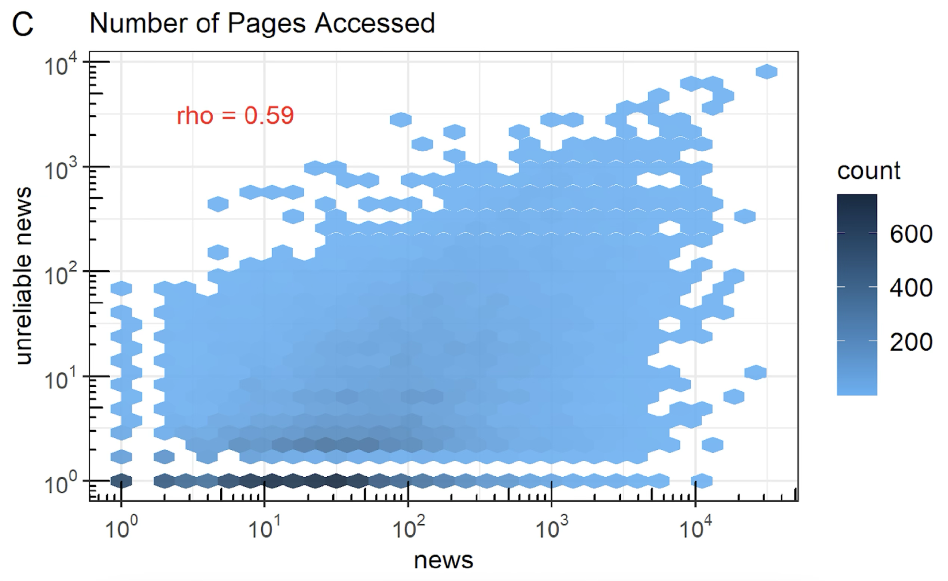
More reliable news -> More misinformation exposure

Slide 17
Data and Methods
Measure 3: Ideological Scores of News Domains
Ad Fontes (e.g., Aslett et al., 2022)
Samples articles on news domains’ websites and employs an ideologically balanced panel of experts to rate news article’s ideological slant
Ranges from -38.5 (most extreme liberal bias) to +38.5 (most extreme conservative bias)
Audience-based measure of news domain bias (e.g., Tyler et al., 2021; Yang et al., 2020)

Slide 18
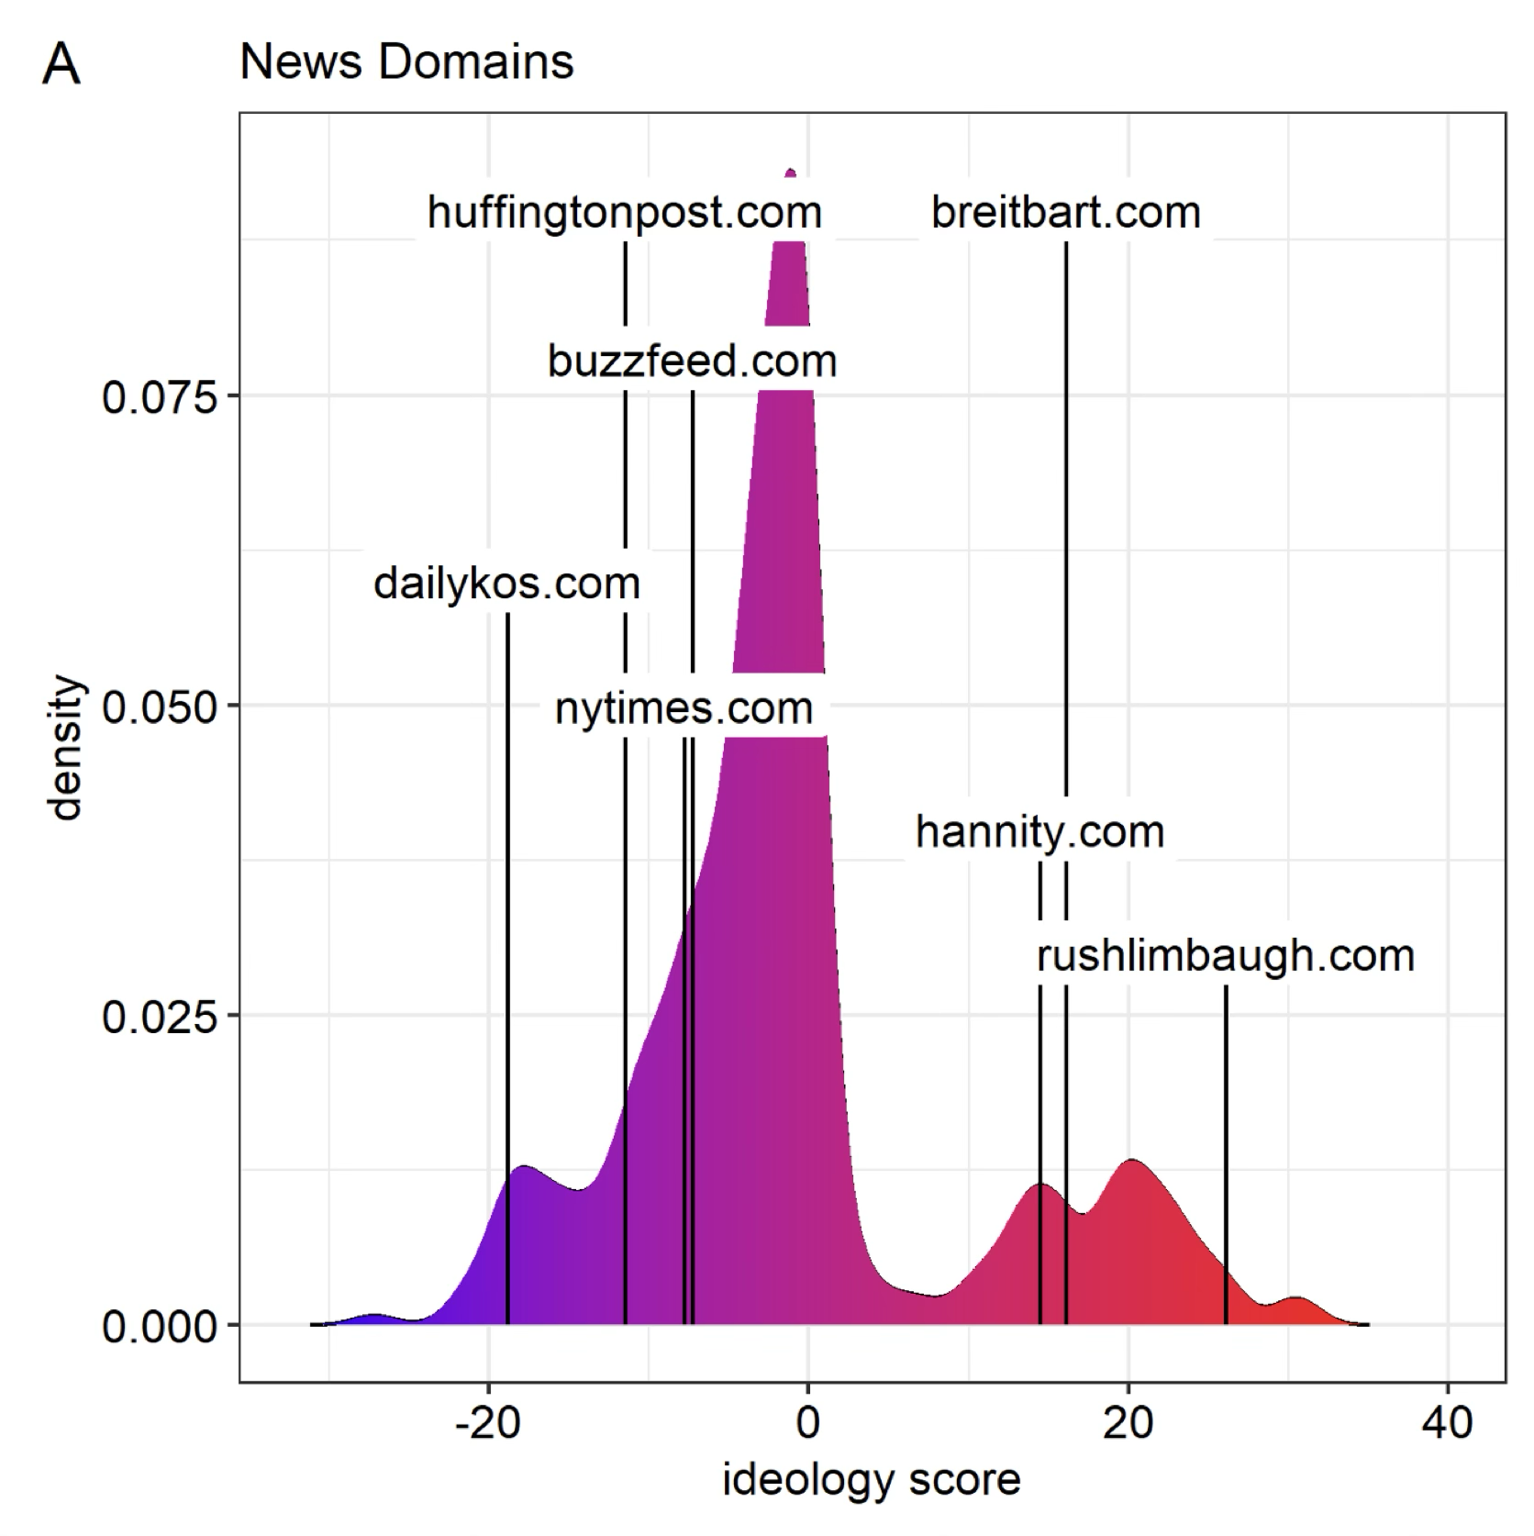
Ideological Scores of News Domains

Slide 19
Data and Methods
Measure 4: Diversity of News Diets
Pairwise ideological distance for news pages visited by the panelists by month
If panelist i accessed three pages in month m from the Activist Post, BuzzFeed, and the New York Times, we first calculate the ideological distance between each pair of these outlets, and then average the pairwise distances to a summary statistic for panelist i in month m
Smaller when accessing ideologically similar domains
Larger when accessing ideologically diverse domains
Notes:
In general, most panelists have a homogenous news diet, but there is some heterogeneity: because of the way in which the ideology scores are calculated, scores that seem small in magnitude are still signaling meaningful diversity in the information accessed by panelists.

Slide 20
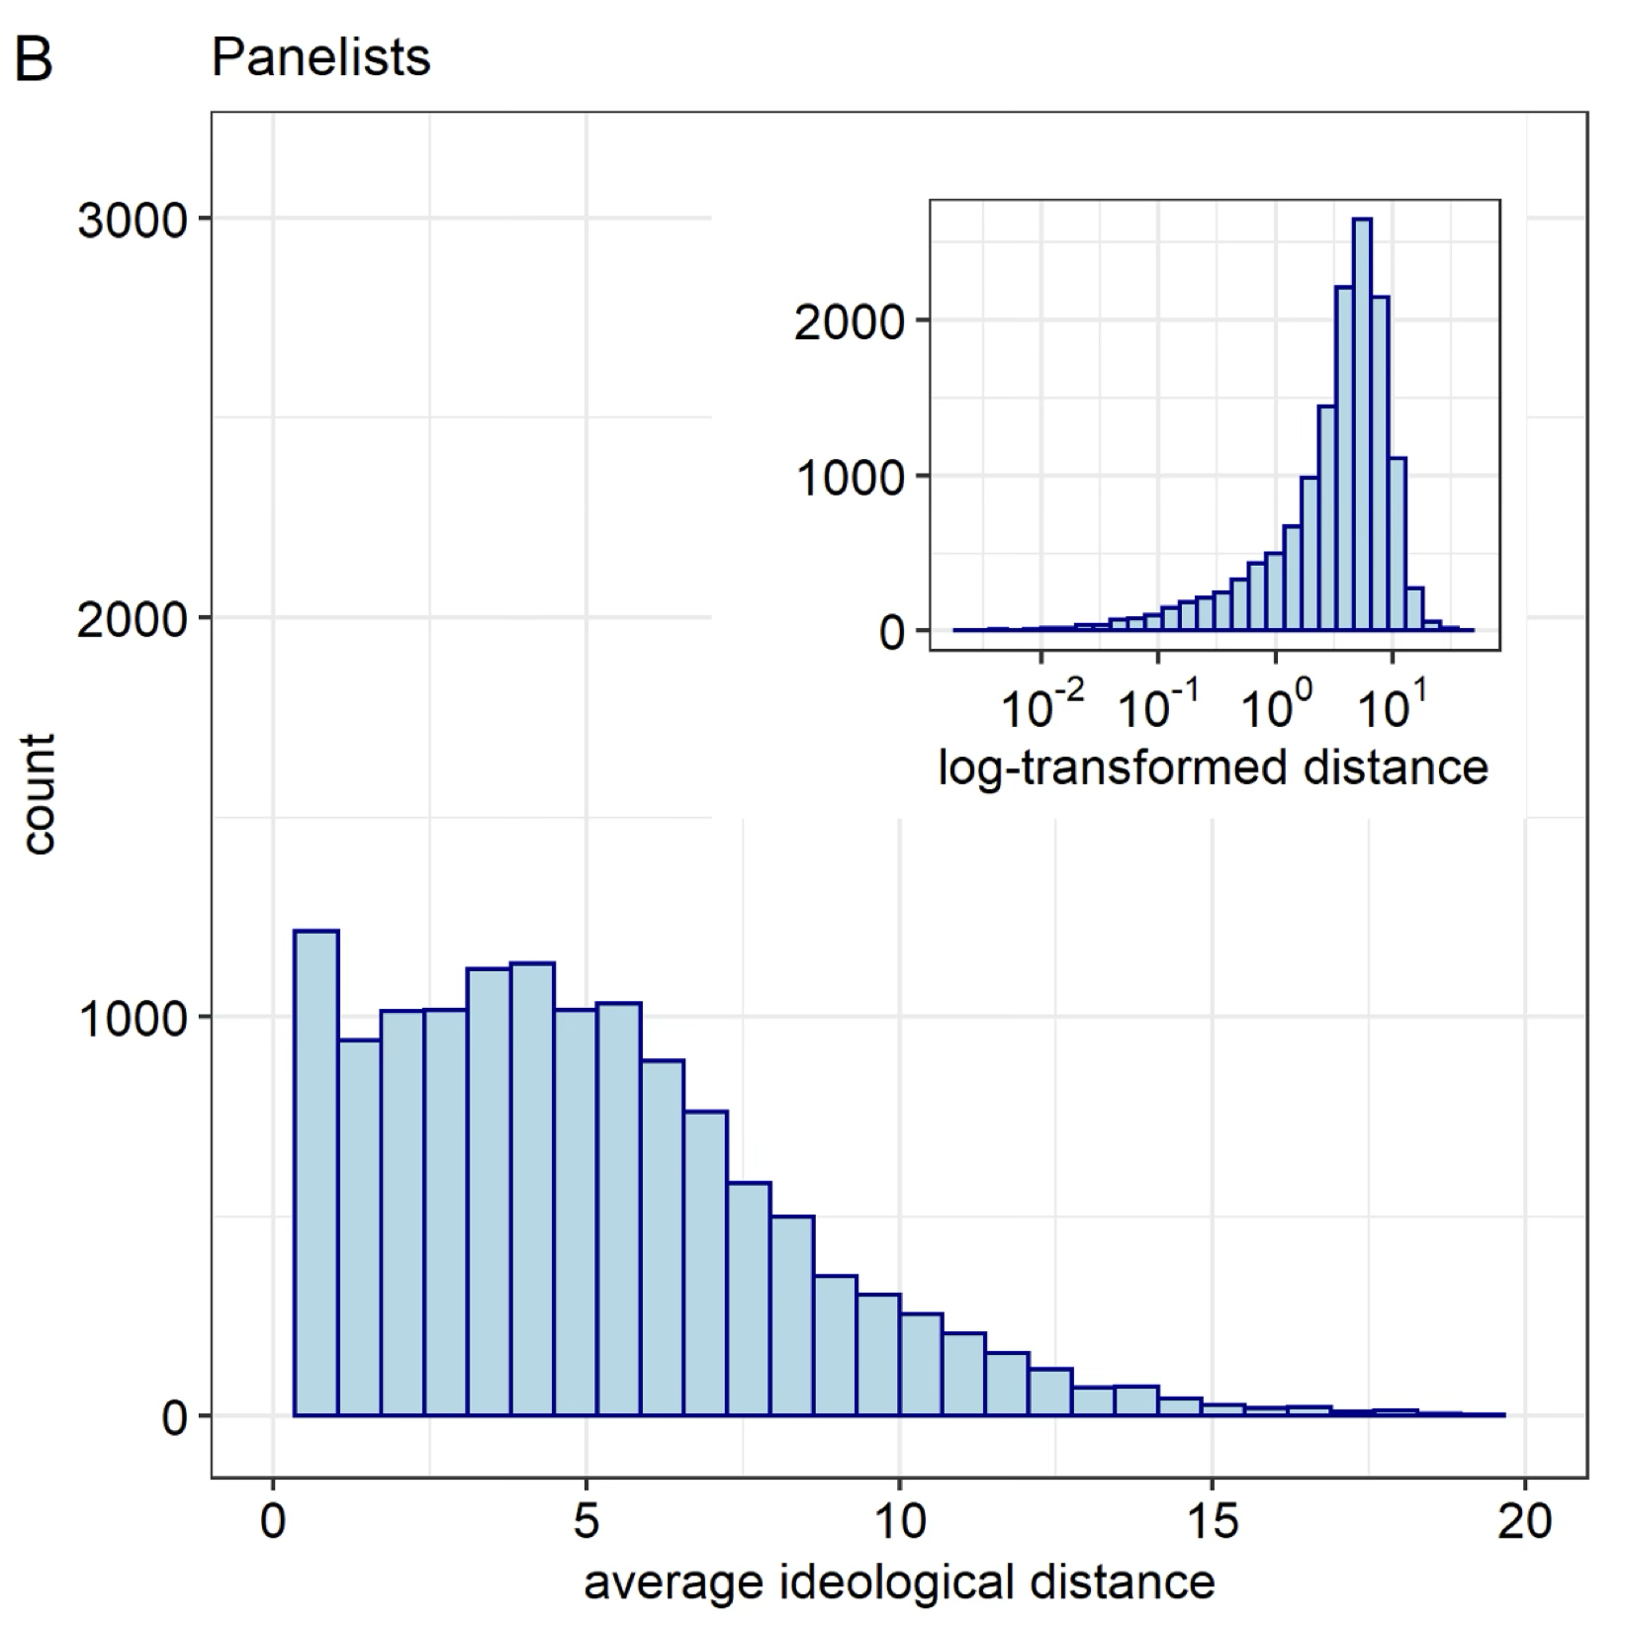
Diversity of News Diets (Ideological Distance)
Notes:
In general, most panelists have a homogenous news diet, but there is some heterogeneity: because of the way in which the ideology scores are calculated, scores that seem small in magnitude are still signaling meaningful diversity in the information accessed by panelists.

Slide 21
Data and Methods
Measure 5: Demographic Variables
Gender, age, education, employment status, race, ethnicity, and income
Panelists’ partisan leaning:
Instead of self-disclosed party affiliation, we extrapolate the partisan leaning of our panelists by averaging ideological scores of the news pages they visited each month
More flexible and granular:
It can change from month to month (if news diets change)
Differentiate individuals that would otherwise look identical in their party affiliation based on self-reports

Slide 22
So, what variables we have now?
Variable 1 (DV): Misinformation Exposure
Number of unreliable pages accessed
Time spent on those pages
Variable 2 (IV): Number of news pages accessed
Variable 3 (IV): Ideological Distance (among visited pages)
Variables 4: Demographic Variables (including partisan leaning)
Linear mixed effects model, with panelist ID and month as random effects. All variables were scaled and log-transformed where appropriate.

Slide 23
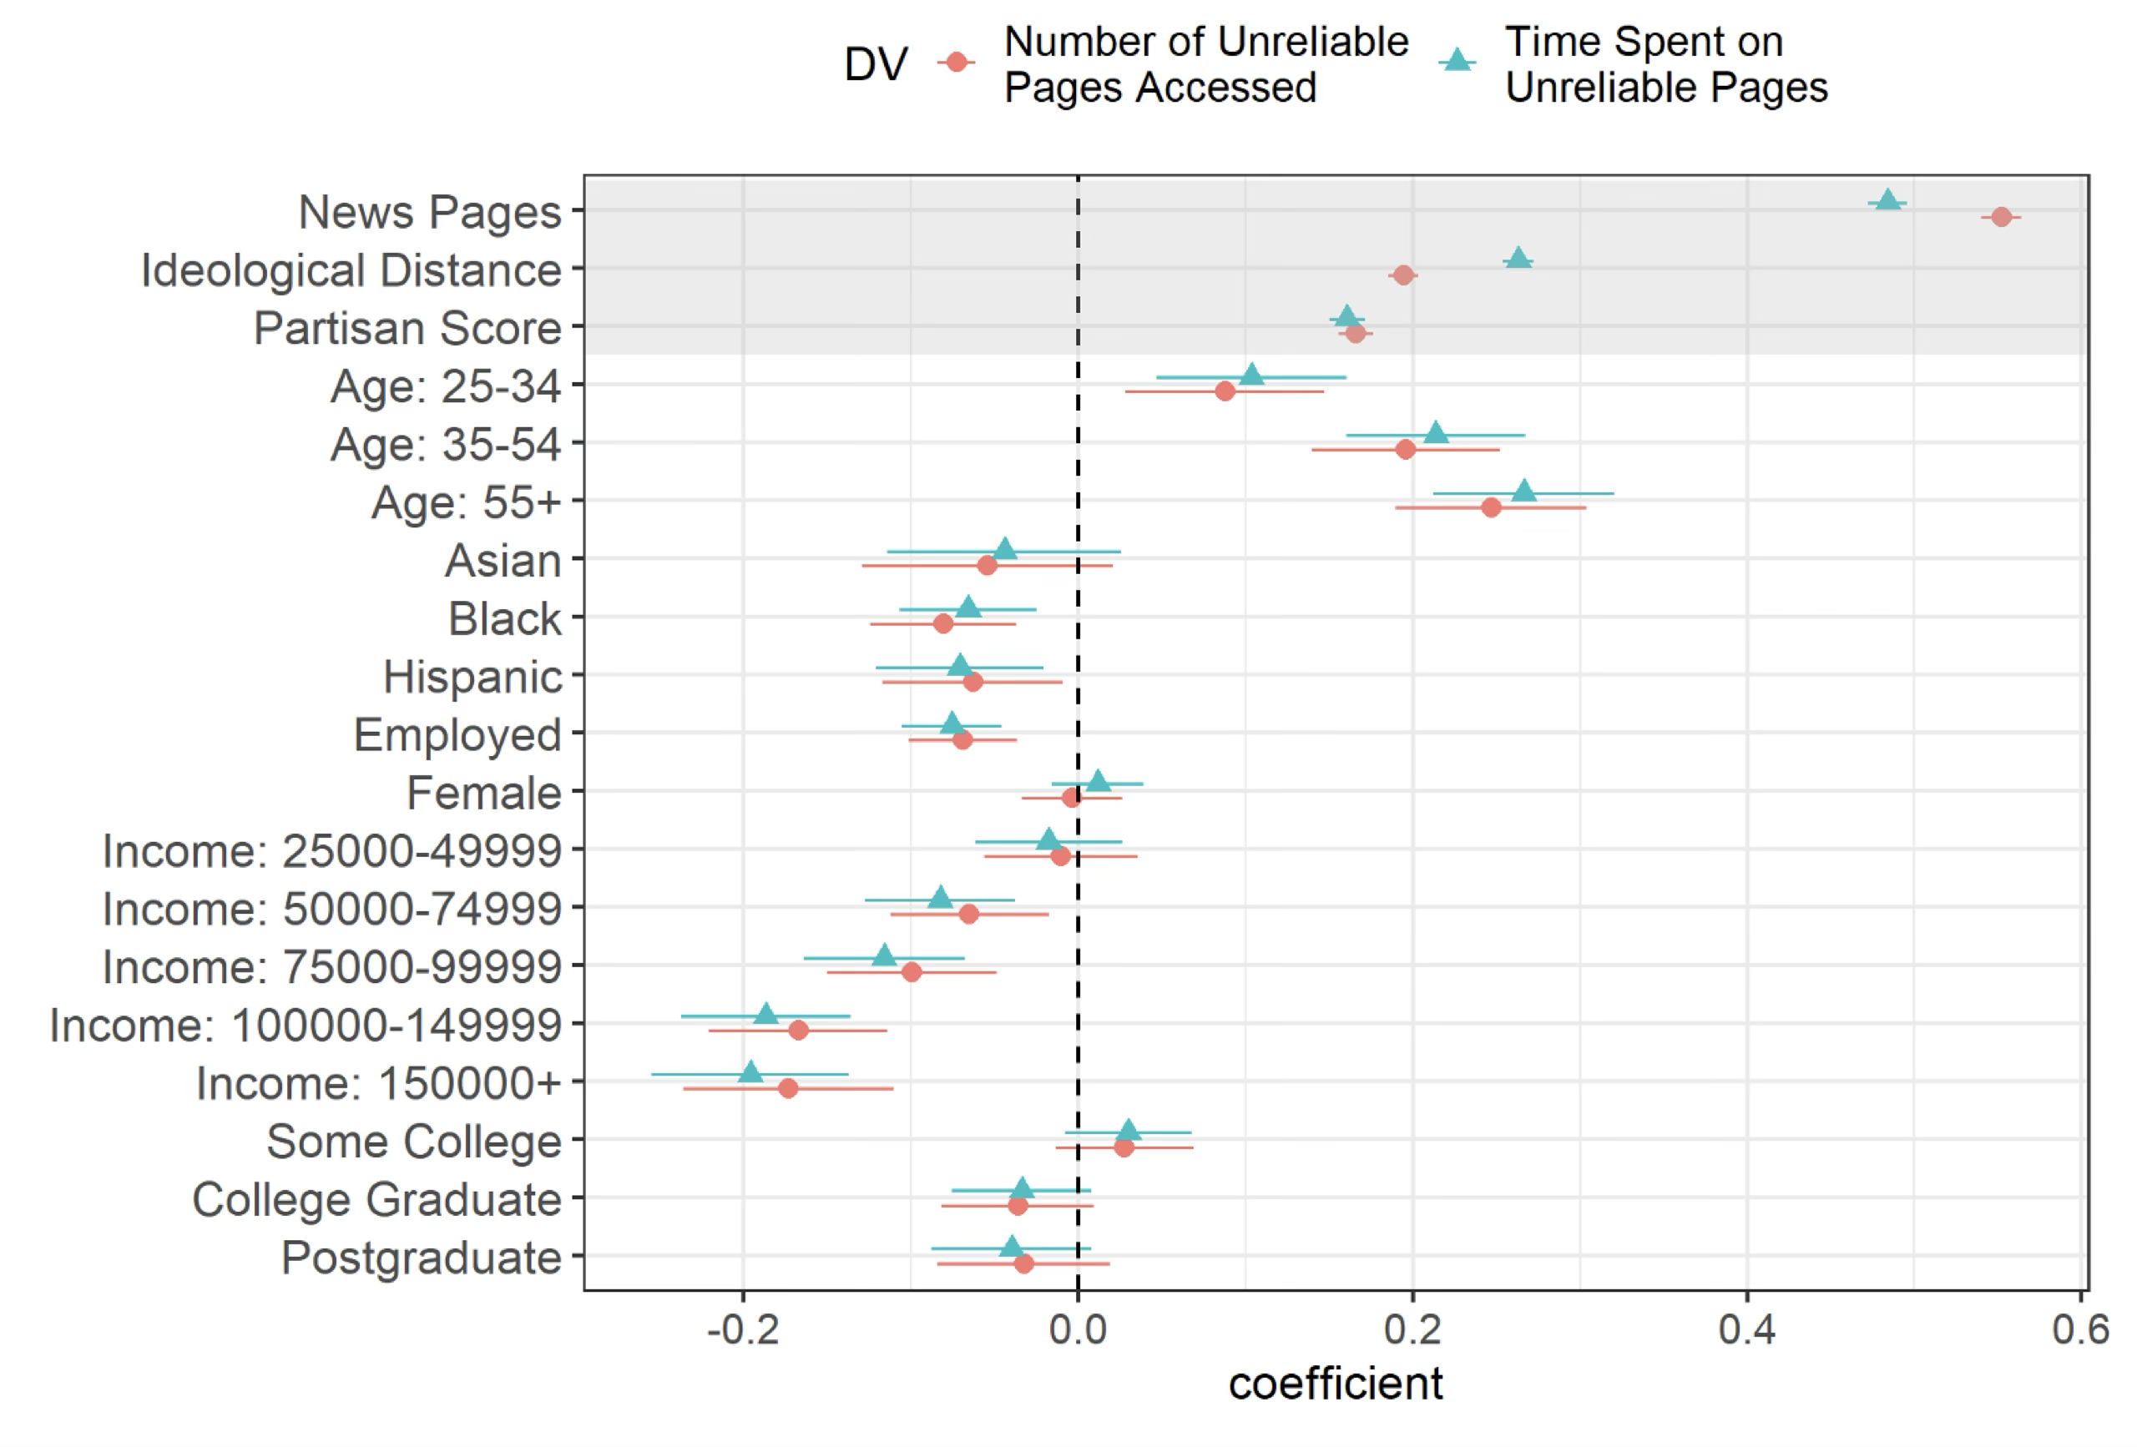
More diverse news diets -> More misinformation exposure

Slide 24
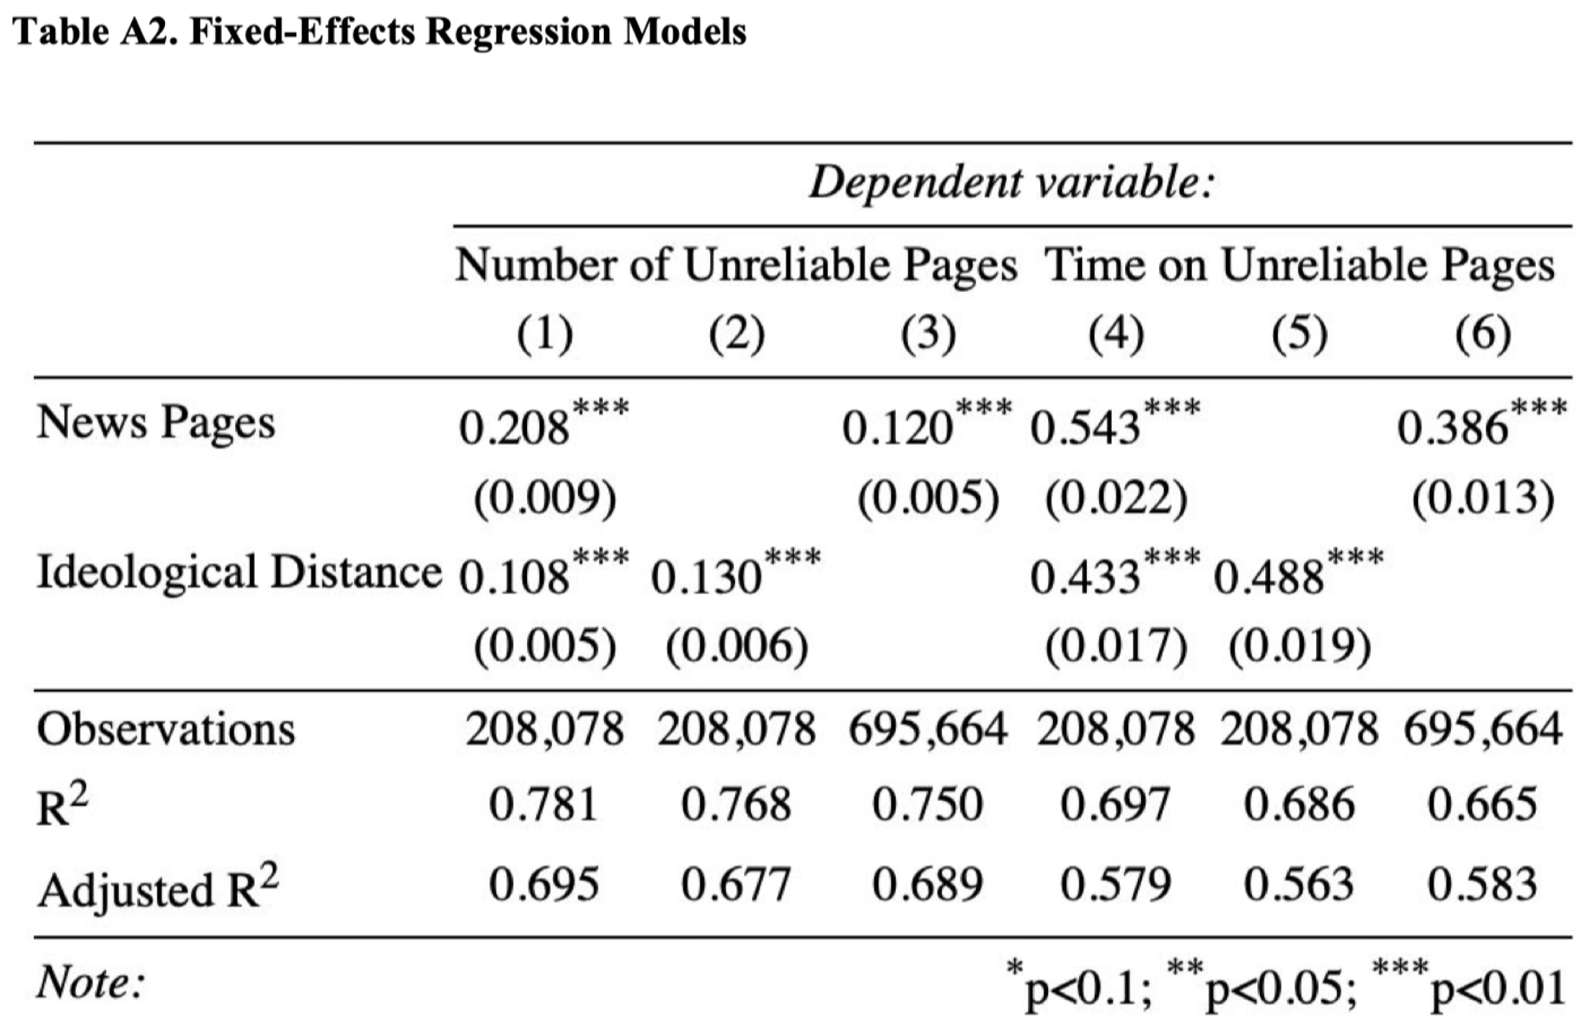
How about within-person effects?

Slide 25
Guess where we start from?

Slide 26
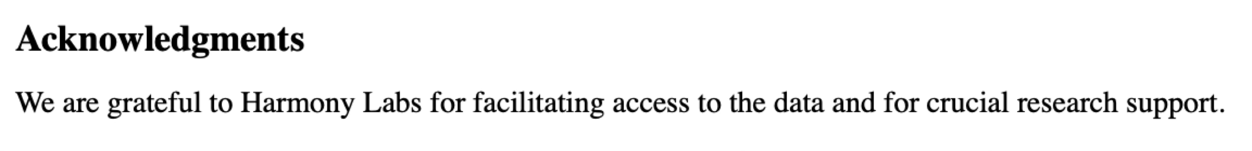
Guess where we start from?
Starting from Data
Harmony Labs is a nonprofit media research lab, that regularly posts CFPs for dataset access
Access to their Nielsen Web panel data (~ 140,000 unique users in the United States; what they visit at the URL level for the year 2018 & their demographic and weight)
From data to question (Tian and I): “the paradox between cross-cutting news consumption and misinformation exposure”
From question to method (Sandra): average clustering coefficient Lydon-Staley et al. (2021) or pairwise ideological distance

Slide 27
Study 2
Zhou, A., Capizzo, L. W., Page, T. G., & Toth, E. L. (2023). Exploring public relations research topics and inter-cluster dynamics through computational modeling (2010-2020): A study based on two SSCI journals. Journal of Public Relations Research, 35(3), 135–161. https://doi.org/10.1080/1062726X.2023.2180373

Slide 28
Case: Zhou et al. (2023)
Exploring PR research topics via topic modeling
Use STM to identify topics and clusters
Compare topic distributions across journals and time
Network simulation to test inter-cluster dynamics

Slide 29
RQ & Findings
What topics do public relations scholars study?
What clusters/themes emerge?
Do these clusters/themes intersect with each other?

Slide 30
RQ & Findings
What topics do public relations scholars study?
What clusters/themes emerge?
Do these clusters/themes intersect with each other?
Identify 65 topics
These 65 topics cluster into 9 subfields
These subfields do not talk to each other

Slide 31
Data and Methods
Web Scraping Data
Time: from 2010 to 2020
Journals:
Public Relations Review (PRR)
Journal of Public Relations Research (JPRR)
1093 papers from PRR and 200 from JPRR
7,400,685 words

Slide 32
Data and Methods
Method 1: Structural Topic Modeling
We identified 65 topics, such as
“Twitter” “Facebook”
“Relationship management” “Nonprofit Management”
“Image Repair” “Situational Crisis Communication Theory”

Slide 33
Data and Methods
Method 1: Structural Topic Modeling
We identified 65 topics, such as
“Twitter” “Facebook” --- “Digital Media”
“Relationship management” “Nonprofit Management” --- “Strategic Management”
“Image Repair” “Situational Crisis Communication Theory” --- “Crisis Comm”

Slide 34
Data and Methods
Method 1: Structural Topic Modeling
We identified 65 topics, such as
“Twitter” “Facebook” --- “Digital Media”
“Relationship management” “Nonprofit Management” --- “Strategic Management”
“Image Repair” “Situational Crisis Communication Theory” --- “Crisis Comm”
<Like, comment, and share on Facebook: How each behavior differs from the other> is detected to have:
Digital Media (73.7%)
Strategic Management (18.7%)
Public Relations Professionalism (0.1%), Crisis Communication (2.3%), Internal Communication (0.8%), Global Public Relations (0.0%), Rhetoric and Philosophy (0.1%), Media Relations (0.2%), Critical Studies (0.0%)

Slide 35
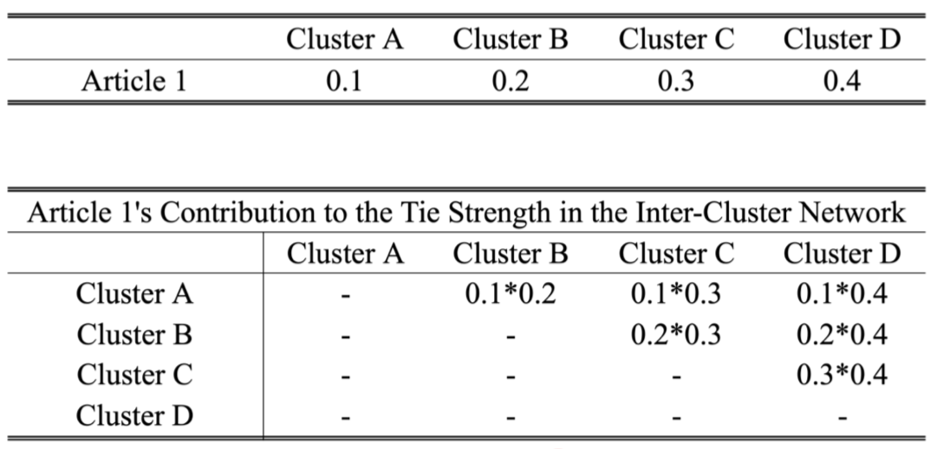
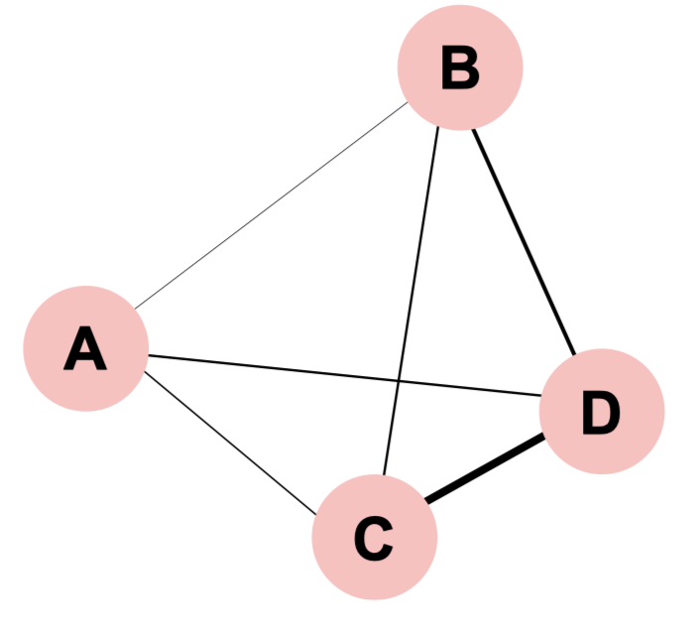
Data and Methods
Method 2: Inter-Cluster Network Analysis

Slide 36
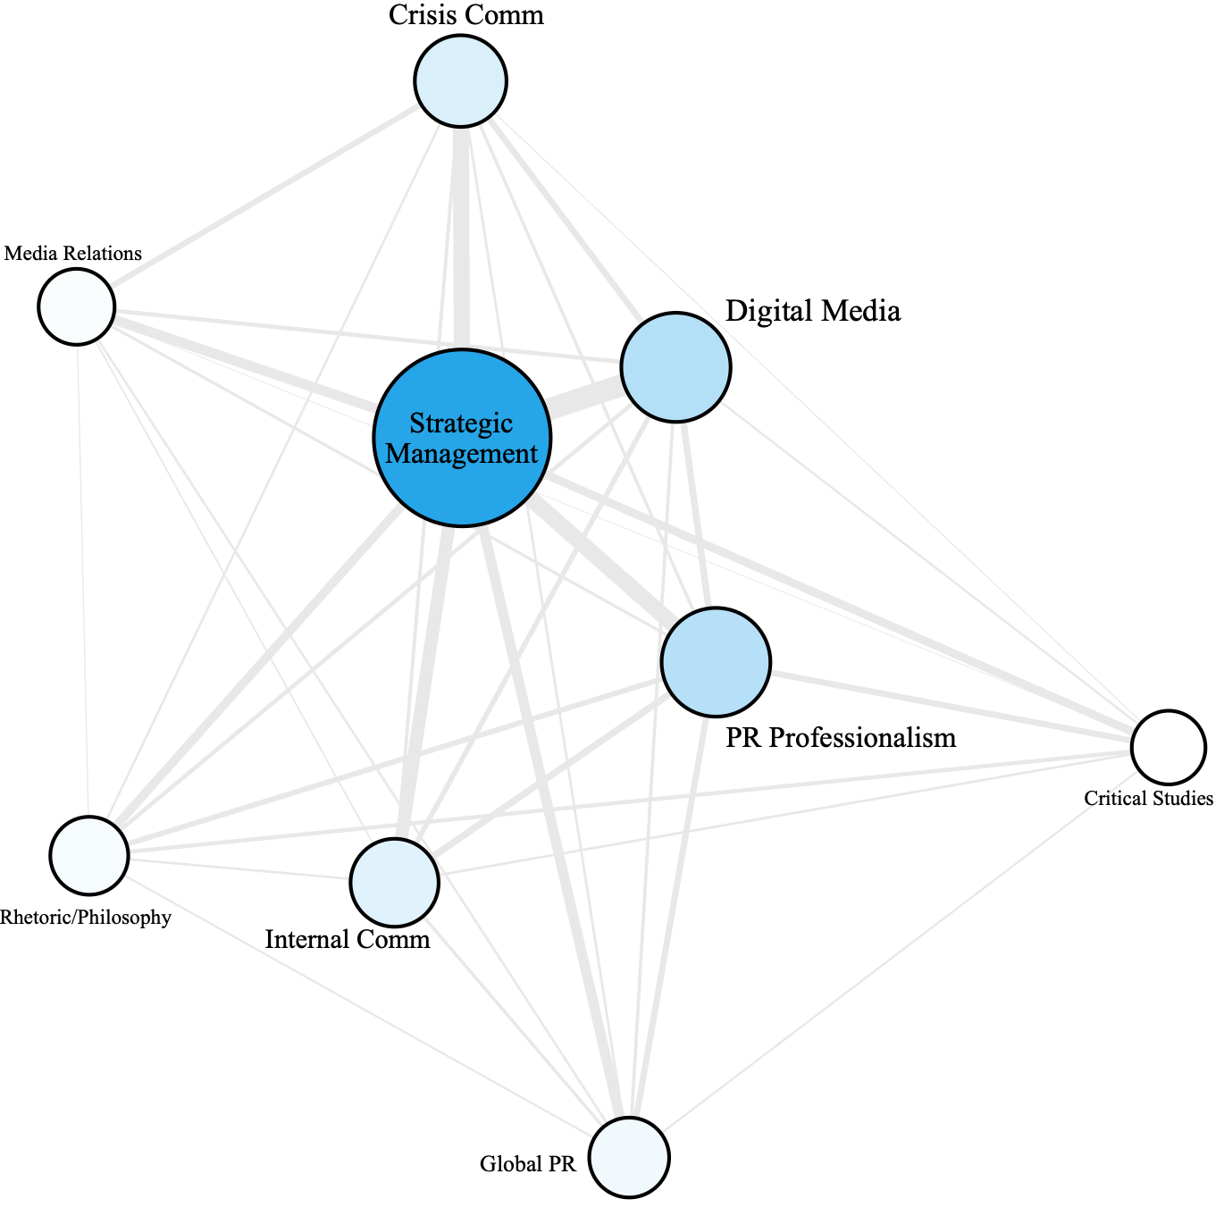
Data and Methods
Method 2: Inter-Cluster Network Analysis

Slide 37
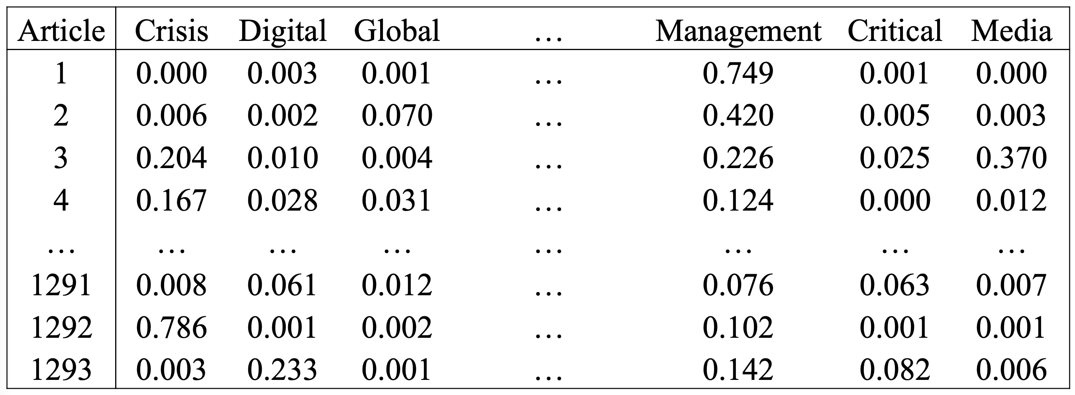
Data and Methods
Method 3: Network Simulation

Slide 38
Data and Methods
Method 3: Network Simulation
For each article, cluster proportions add up to 100%
For each cluster, its proportion across all articles remains the same
 | Cluster 1 | Cluster 2 | Cluster 3 | Cluster 4 | … | Cluster 7 | Cluster 8 | Cluster 9
Paper 1
Paper 2
Paper 3
…
Paper 1292
Paper 1293

Slide 39
Data and Methods
Method 3: Network Simulation
For each article, cluster proportions add up to 100%
For each cluster, its proportion across all articles remains the same
 | Cluster 1 | Cluster 2 | Cluster 3 | Cluster 4 | … | Cluster 7 | Cluster 8 | Cluster 9
Paper 1
Paper 2
Paper 3
…
Paper 1292
Paper 1293

Slide 40
Data and Methods
Method 3: Network Simulation
For each article, cluster proportions add up to 100%
For each cluster, its proportion across all articles remains the same
 | Cluster 1 | Cluster 2 | Cluster 3 | Cluster 4 | … | Cluster 7 | Cluster 8 | Cluster 9
Paper 1
Paper 2
Paper 3 |  |  | [i₁, j₁] |  |  | [i₁, j₂]
…
Paper 1292 |  |  | [i₂, j₁] |  |  | [i₂, j₂]
Paper 1293

Slide 41
Data and Methods
Method 3: Network Simulation
For each article, cluster proportions add up to 100%
For each cluster, its proportion across all articles remains the same
 | Cluster 1 | Cluster 2 | Cluster 3 | Cluster 4 | … | Cluster 7 | Cluster 8 | Cluster 9
Paper 1
Paper 2
Paper 3 |  |  | [i₁, j₁] - ∆ |  |  | [i₁, j₂] + ∆
…
Paper 1292 |  |  | [i₂, j₁] + ∆ |  |  | [i₂, j₂] - ∆
Paper 1293

Slide 42
Data and Methods
Method 3: Network Simulation
For each article, cluster proportions add up to 100%
For each cluster, its proportion across all articles remains the same
1000 Simulated Networks / Alternative Universes/Timelines
95%/5% upper/lower bound as the confidence interval for tie strengths
We simulated “what the field’s interconnection could have been”.

Slide 43
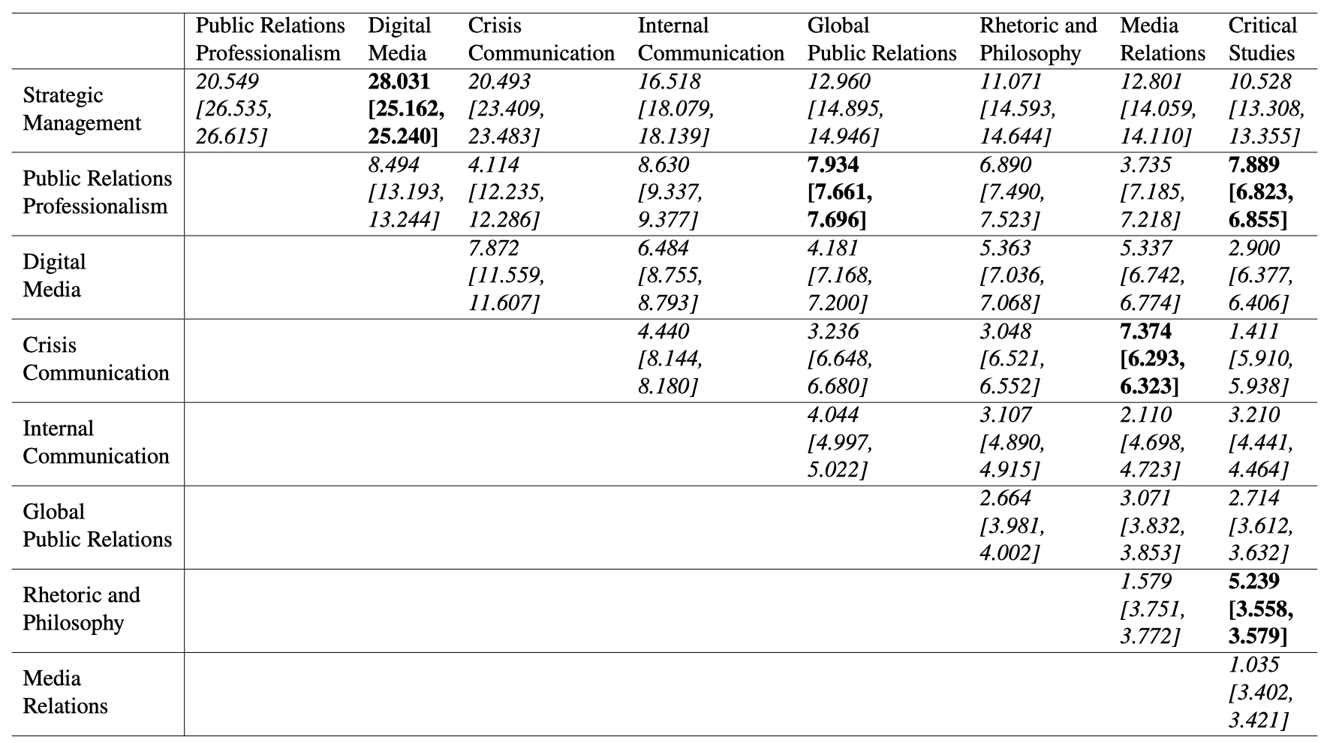
Data and Methods
Method 3: Network Simulation

Slide 44
Guess where we start from?

Slide 45
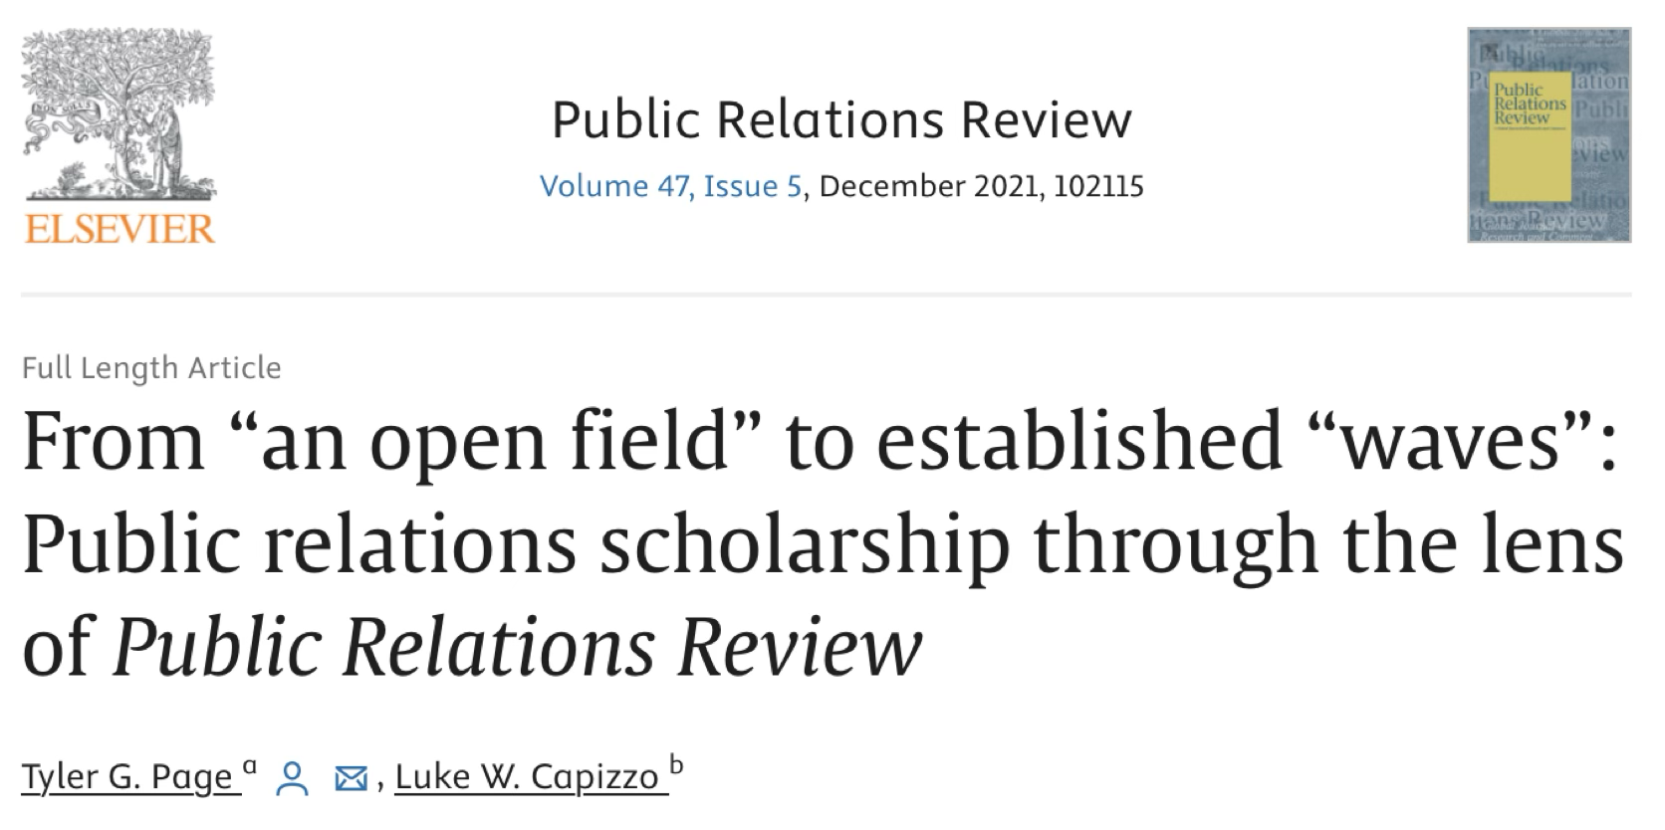
Guess where we start from?
Starting from Question
An interview study by Tyler G. Page (Connecticut) and Luke W. Capizzo (Michigan State)
Interviewees lamented/suspected that many single-topic/cluster review studies omitted signals of inter-topic/cluster development, and there were silos within: PR scholars do not know / work with other PR scholars.
Zoom call with me: “any way we can identify interactions of subfields?”

Slide 46
Guess where we start from?
Starting from Question
From question to method 1: “decompose articles into topics” -> STM
From question to method 2: “intersecting topic/cluster” -> Network
From question to method 3: “silos within” -> Simulation
From method to data: web scraping (or contact journals) and CrossRef

Slide 47
Study 3
Wang, S., Huang, S., Zhou, A., & Metaxa, D. (2024). Lower quantity, higher quality: Auditing news content and user perceptions on Twitter/X algorithmic versus chronological timelines. Proceedings of the ACM on Human-Computer Interaction, 8(CSCW2), 1–25. https://doi.org/10.1145/3687046

Slide 48
RQs and Findings
RQs
Two common rankings for social media feeds:
Algorithmic vs.
Chronological
Algorithm Audit: How do they affect content?
User Audit: How do they affect users?
Findings
Tracking Twitter/X users’ algorithmic vs chronological feeds
Manipulating feed selection and fielding periodical surveys
Algorithmic feed provides less, but better (lower congruence, lower extremity, higher reliability) news URLs.
Changing feeds did not significantly impact user perceptions.

Slide 49
Data and Methods
Intervenr Infrastructure
Web App: Web interface for participant consent / onboarding / survey
Chrome Browser Extension: Collect URLs/engagement and assign conditions
Analysis Pipeline: AWS instance rehydrating t.co to original URLs daily

Slide 50
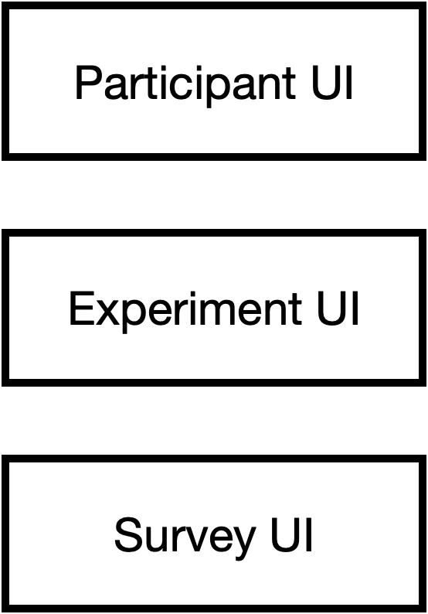
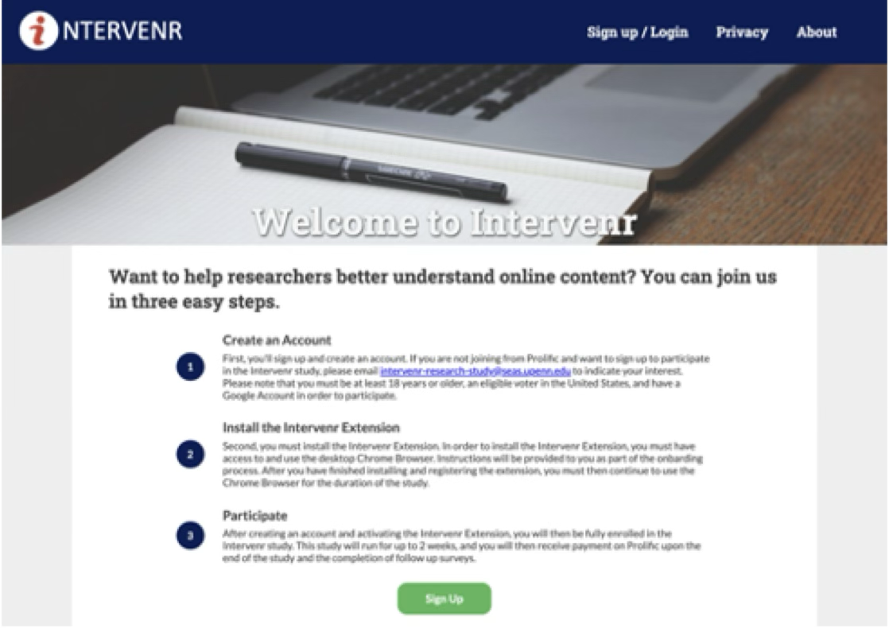
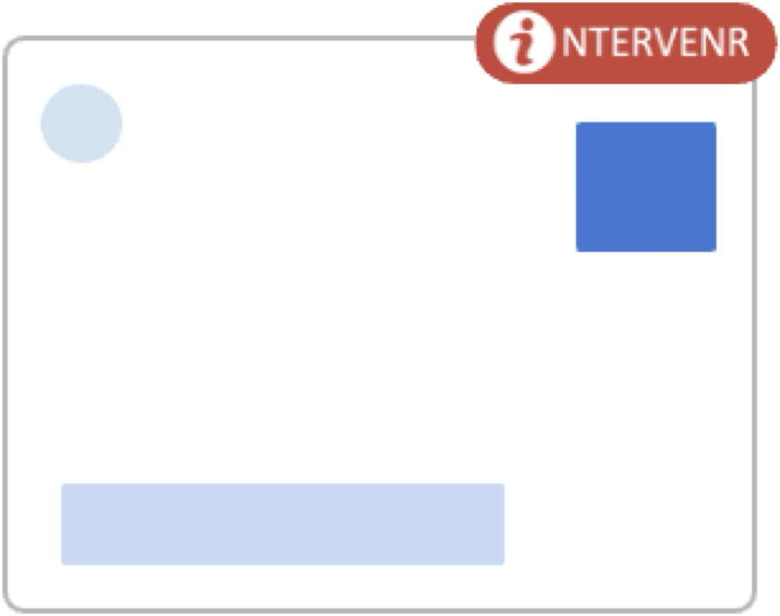
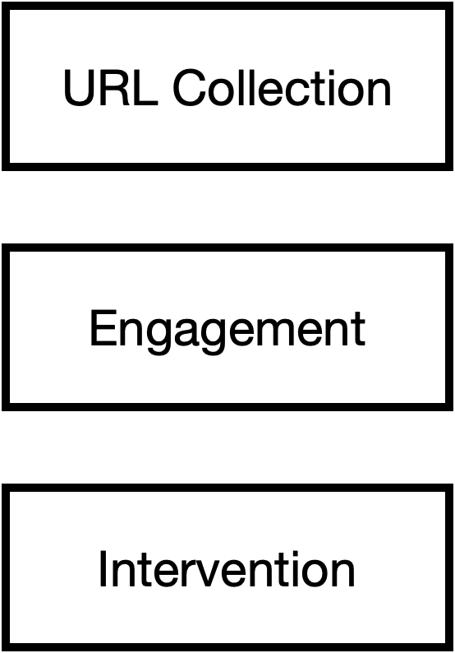
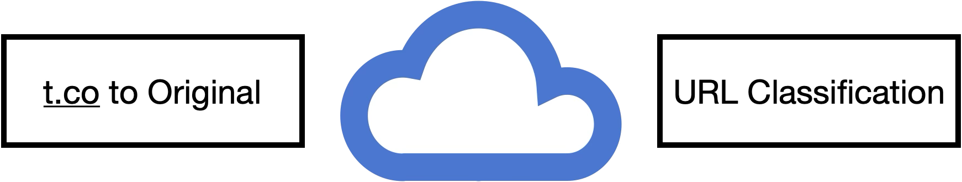
Data and Methods

Slide 51
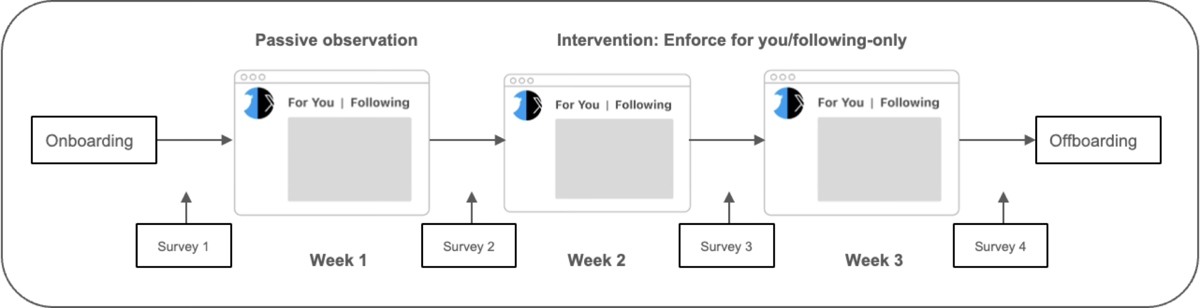
Data and Methods
Study Procedure
Week 1: Survey 1 -> Observation
Week 2: Survey 2 -> either “For You” or “Chronological” -> Survey 3
Week 3: either “Chronological” or “For You” -> Survey 4

Slide 52
Data and Methods
Participant Management
Prolific:
Live in the United States; At least 18 years old; Use Google Chrome as a main web browser; Use Twitter/X; Access Twitter/X from their main web browser at least a few times per week
822 onboard with background survey
243 completed at least two weeks
218 completed the whole 3-week study
$0.25 for screening survey
$5 for each survey; $20 maximum

Slide 53
Data and Methods
Measurement System
Onboarding Survey:
Ideology (-3~+3), Age, Education, etc.
URL Annotation:
Media Bias: Ad Fontes (most liberal -42 to most conservative +42)
News Credibility: Ad Fontes (least credible 0 to most credible 64)
Between-Week Survey:
Perceived echo chambers
Media satisfaction
Perceived news credibility and media trust
Perception of the platform
Notes:
Perceived echo chambers: Roughly estimate the ideological bias of the news on Twitter/X in the past week for their own timeline, for a typical Democrat’s timeline, for a typical Republican’s timeline, and overall on Twitter/X. a 100-point feeling thermometer
Media satisfaction: whether they were satisfied with the news information they saw on Twitter/X in the last week. 5-point Likert scales (“extremely unsatisfied” to “extremely satisfied”).
Perceived news credibility and media trust: estimate the credibility of the news information they see on Twitter/X (from “extremely low credibility” to “extremely high credibility”) and their trust of that information (from “extremely distrust” to “extremely trust”), both measured on 5-point Likert scales.
Perception of the platform: whether Twitter/X is generally neutral, or whether it instead tends to support liberals or conservatives, answered on a 5-point Likert scale (”primarily supports liberals’ posts” to ”primarily supports conservatives’ posts”).

Slide 54
Data and Methods
Dataset
846,494 Tweets
313,517 during observation (first week)
253,471 during first intervention (second week)
279,506 during second intervention (third week)
Users engaged (liked, commented, retweeted) 1.89% (16,014) of them
1.75% (14,817) tweets contained external news URLs
All analyses are conducted at the user level with userID as random effects
i.e., compare one participant’s natural vs. chronological vs. algorithmic

Slide 55
Observation Week
News Density
1.6% of tweets in the algorithmic timeline contained a news URL
7.5% in the chronological timeline contained a news URL
In the chronological/algorithmic timeline
Right-leaning users saw a moderate amount (13.5/11.8% of all news links) of news links from left-leaning news domains
Left-leaning users saw very little (1.5/2.7% of all news links) news links from right-leaning news domains

Slide 56
Algorithm Audit
Ideological Congruence
Weighted Congruence Score: (-3 user)*(-8.13 NYTimes) = 24.39
More congruent in chronological > algorithmic (𝑝 = .031)
News Extremity
Mean Absolute Bias: |-8.13 NYTimes| = 8.13
More extreme in chronological > algorithmic (𝑝 = .003)
News Reliability
? More reliable in algorithmic > chronological (𝑝 > .05)

Slide 57
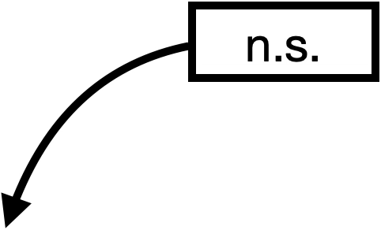
Algorithm Audit

Slide 58
User Audit
User Exposure
More news URLs in chronological > algorithmic (𝑝 = .002)
User Engagement
More tweets and engagement (𝑝 < .001) in algorithmic > chronological
? More engagement with tweets with news URLs (𝑝 > .05)
User Satisfaction
Users hated us enforcing timeline sorting (from 3.38 to 3.23/3.21)

Slide 59
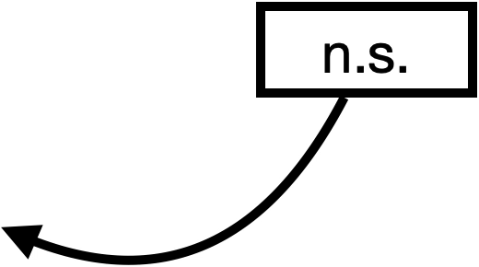
User Audit

Slide 60
User Audit
User Perceptions of Bias
Perceptions of bias associated with their actual news bias (𝑝 < 0.001)
Their exposure to news bias did not change their perceptions of:
The average bias of all news links available on Twitter
Whether the Twitter/X algorithm favors conservatives or liberals
User Perception of Credibility
Exposure to news of higher credibility leads to less perceived credibility (𝑝 = .012) and lower media trust (𝑝 = .002)
User Perception of Other Users
“A typical Republican’s timeline is less conservative than I thought.”
“A typical Democrat’s timeline is more liberal than I thought.”

Slide 61
Guess where we start from?

Slide 62
Guess where we start from?
Starting from Method
Danaë (HCI, Computer Science) developed the Intervenr infrastructure
With their secondary appointment in communication, let’s audit/intervenr news?
What platform to audit?
What changes to make for extension/Prolific/surveys?
What news consumption topics should we investigate?

Slide 63
Guess where we start from?
Starting from Method
From method to question: Algorithmic vs. Chronological
From method to data: Participants’ Twitter timelines across 3 weeks
From method to data: Acquiring Ad Fonte, NewsGuard, and comScore

Slide 64
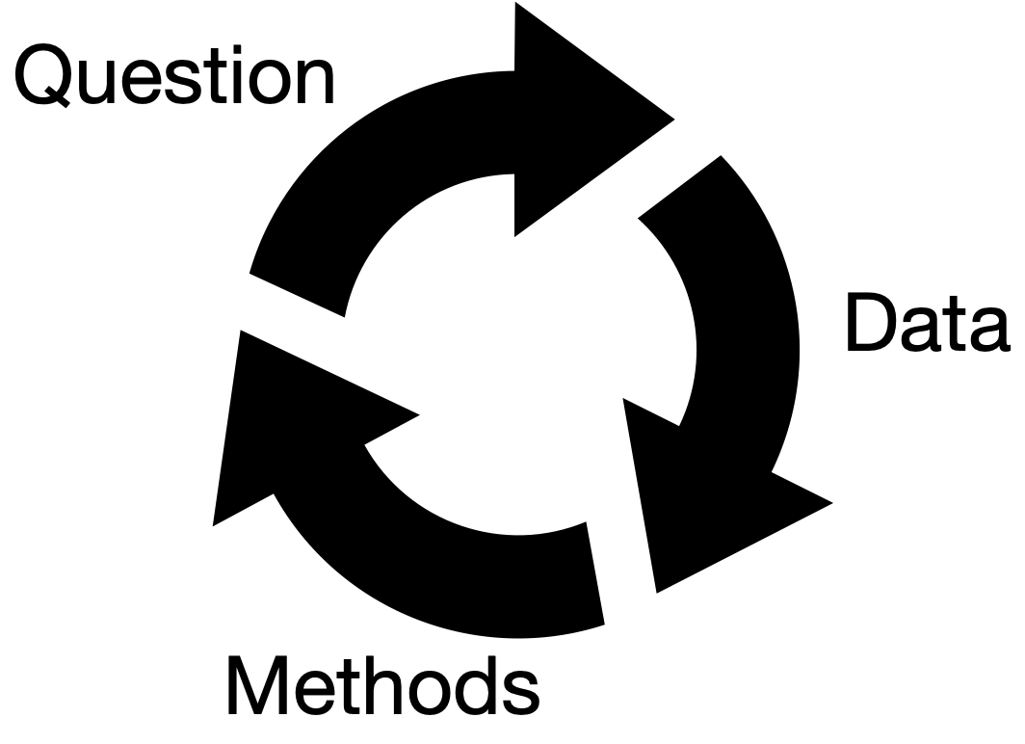
Instead of blindly applying computational methods to social data, computational social scientists should forge synergy between question, data, and method — starting with an interesting research question, or some invaluable data, or an innovative methodological framework — to create a research design that tells a compelling social science story.

Slide 65
Computational social science > computational methods / social media / big data
Research design (i.e., the “so what”) is more important than the data
CSS studies tell stories, and ask yourself if your story is compelling
If you are starting from scratch, (maybe) start from the question.

Slide 66
Looking Ahead
If the discussion of CSS philosophy is too high-level, what can we do in practice when conducting our studies?
Some Directions I Think That Are Valuable
Computational Storytelling:
Molding data, questions, and methods simultaneously
One Story, Deeply Told
DEMM Framework (Description → Experimentation → Mediator/Moderator identification)
Methodological Triangulation
Social Good and Ethical Imperatives
In the end, we will touch upon LLM

Slide 67
One Story, Deeply Told
Barari, S. (2024). Political speech from corporate America: Sparse, mostly for Democrats, and somewhat representative. Journal of Quantitative Description: Digital Media, 4. https://doi.org/10.51685/jqd.2024.icwsm.5
High-resolution coding of sparse, noisy behavior
How careful annotation, domain understanding, and scale can come together
In CSS, “big” doesn’t have to mean “messy” or “shallow”
Sometimes the best computational study is a narrow, well-told story.

Slide 68
DEMM Framework
Description → Experimentation → Mediator/Moderator identification
Describe the social phenomenon you are addressing
Collect observational data
Computational tools
Large-scale, multiple contexts
Simple descriptive analyses, visualizations, and correlations
Experiment on the mechanism you are interested in
Field or digital interventions that test mechanism
Mediator/Moderator
Unpack how and for whom effects operate
CSS often begins with a description, but must not stop there.

Slide 69
Presentation: Lee (2021)

Slide 70
Methodological Triangulation
Nelson, L. K. (2020). Computational grounded theory: A methodological framework. Sociological Methods & Research, 49(1), 3–42. https://doi.org/10.1177/0049124117729703
Ophir, Y., Walter, D., & Marchant, E. R. (2020). A collaborative way of knowing: Bridging computational communication research and grounded theory ethnography. Journal of Communication, 70(3), 447–472. https://doi.org/10.1093/joc/jqaa013
Than, N., Fan, L., Law, T., Nelson, L. K., & McCall, L. (2025). Updating “the future of coding”: Qualitative coding with generative large language models. Sociological Methods & Research. https://doi.org/10.1177/00491241251339188

Slide 71
Social Good and Ethical Imperatives

Slide 72
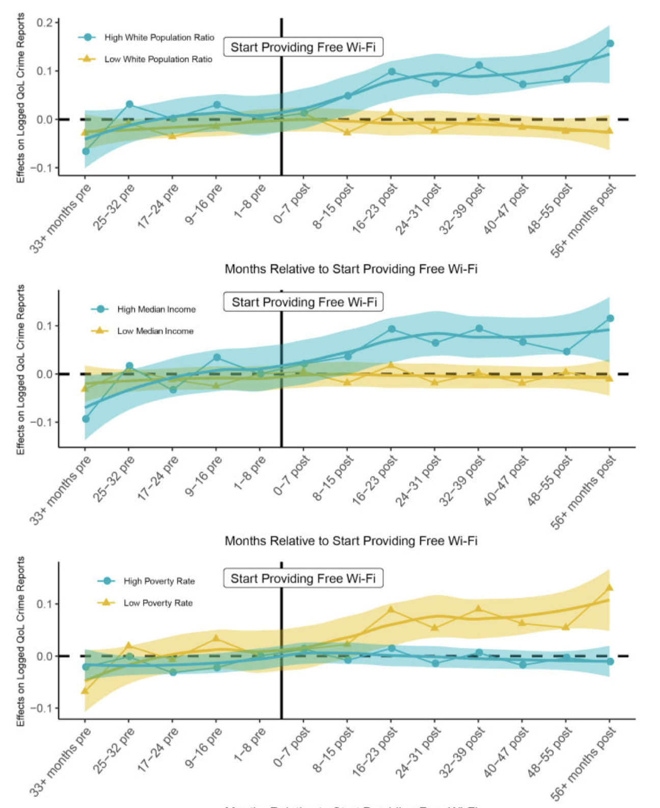
Presentation: Yang et al. (2021)

Slide 73
Presentation: Yang et al. (2021)
Shows that digital access (Wi-Fi in commercial spaces such as Starbucks) isn’t just passively unequal—it’s actively policed.
Design:
Treatment: Free Wi-Fi introduction at 226 chain restaurants.
Outcome: Change in Quality-of-Life (QoL) crime reports (e.g., loitering).
Controls: Fixed effects for store and month-year.
Quasi-experiment using geo-located crime and business license data.
Leverages a staggered difference-in-differences design in Chicago.
Contextual moderators: Racial composition and affluence of the neighborhood.

Slide 74
Presentation: Wang et al. (2022)

Slide 75
Generative AI: A New Frontier
LLM
Text synthesis and augmentation
Multilingual content coding
Simulated social agents and interactions (e.g., Park et al. 2023: Generative Agents)
New dilemmas
What counts as authorship?
Can LLMs reinforce biases or ideologies?
What LLM means for social theories?

Slide 76
Lab Preview
LLM coding (Jiacheng Huang guest lecture)

